Slide 1
Issues Facing Bitcoin
There are a few

Slide 2
Overview
Scalability
Block Size
Lightning Network
IOTA
Data Usage
Neutrino
Fungibility
What is Fungibility
How can we achieve it with a blockchain (Monero)
Off-Chain Solutions + Atomic Swaps
Regulation
Bitlicense + Ben Lawsky
ETFs
Legality: Silk Road and Money Laundering

Slide 3
Scalability
Blockchains are the most inefficient databases to be invented. In order to ensure the legitimacy of each transaction, massive computing power is required. In addition, Bitcoin can only handle 7-10 transactions per second. VISA in comparison, can do 24,000 TPS.
Different teams and chains have proposed different solutions:
BCash (BCH) plans to grow the block size (now at 128MB) to allow for more TXs per block. BTC’s block size is 1MB.
Bitcoin (BTC) has fully implemented a second layer solution called Lightning.
Altcoins try to solve these with more aggressive innovation, but nothing has worked yet. (IOTA, BCash, ETH)

Slide 4
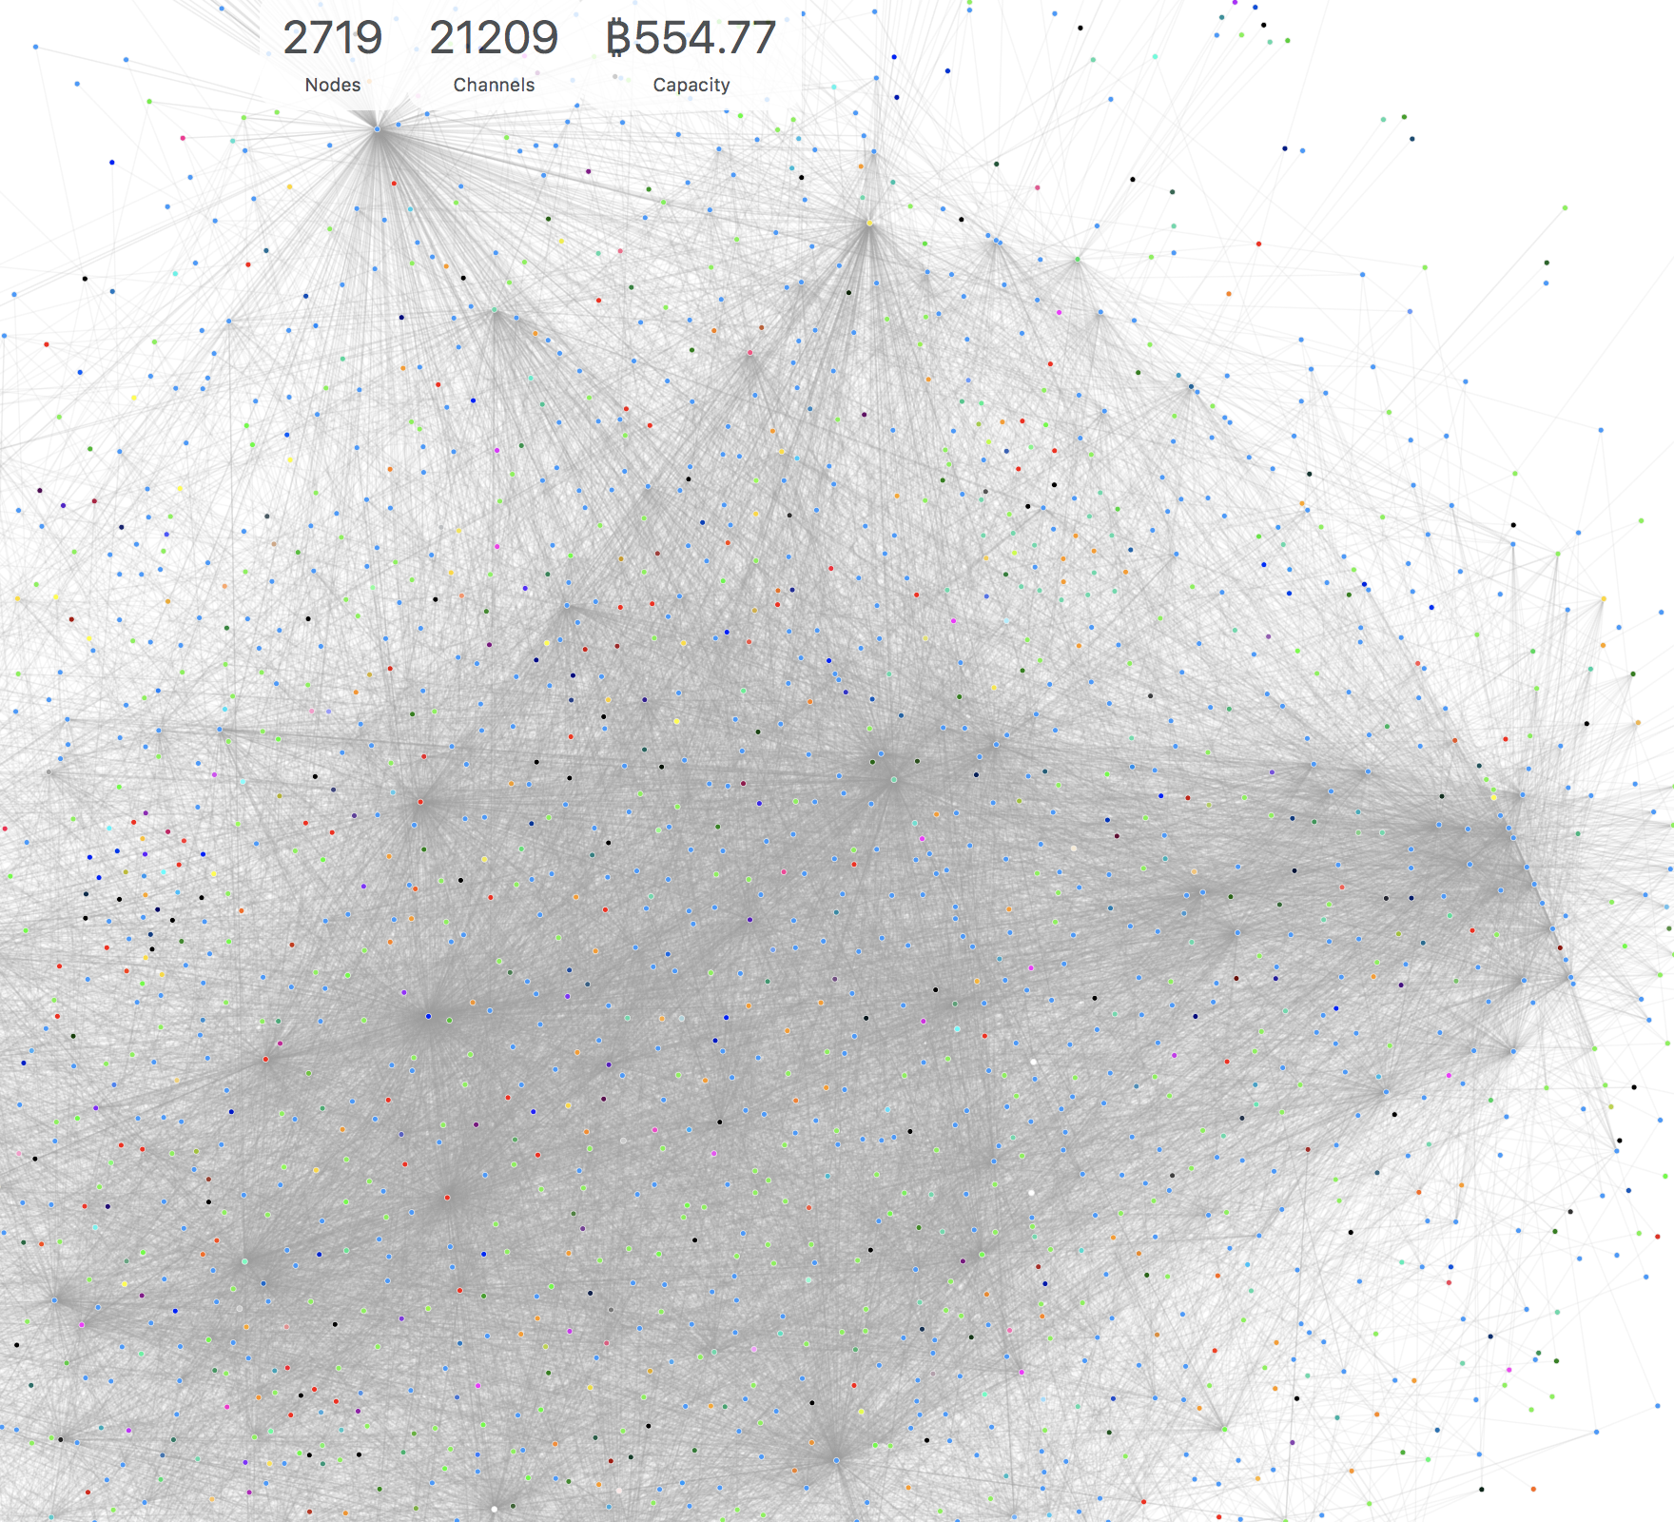
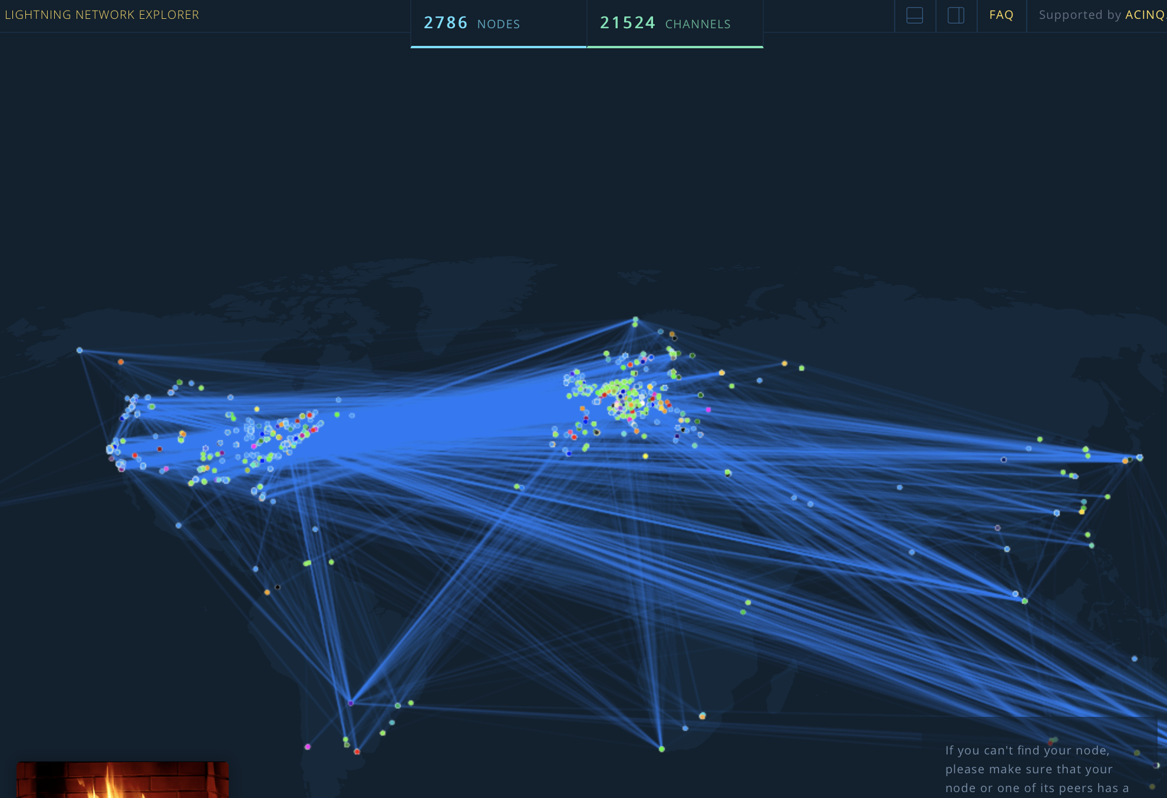
⚡ Lightning Network ⚡
By Joseph Poon, and Thaddeus Dryja
A Second layer solution, meaning not on-chain, but directly tied to it.
To “run lightning”: you must (as of now)
Run a full BTC node.
Withdraw BTC from a wallet and put it in a LN wallet
Send it to a smart contract “wallet” which you share with 1 other LN node. This establishes a bidirectional payment channel.
When both nodes have contributed funds, anyone connected to your nodes (even distantly) can send money through you. Your personal ledger in that channel auto-updates, and any funds you route pay you very small fees.
Visualizations of the LN, digital above and geographical below. (links)

Slide 5
Data Usage
As of now, the Bitcoin blockchain is over 220GB of data. The ETH blockchain is over 1 TB.
Several developers are worried about the ever increasing costs this imposes on the opening of new nodes.
Already, apps have been developed allowing “light clients”. These allow users to transact and verify payments without storing the entire ledger. Instead, they simply connect to a remote node run by a company.
Two better solutions have been proposed: Neutrino and Utreexo

Slide 6
Neutrino
I honestly don’t know what this is yet. Check back Later.

Slide 7
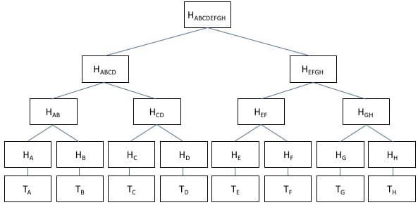
Utreexo
TLDR: Merkle everything?
Utreexo was conceived by Thaddeus Dryja (inventor of the LN).
Central Idea: Form a merkle root of all existing UTXOs, adding and cutting new ones with each new block.
Notes:
Older and larger UTXOs can form the base, where they are unlikely to move, while younger and small ones can rest at the “end” as part of the smaller trees.

Slide 8
Fungibility
What is Fungibility:
The principle that each UTXO (BTC) is interchangeable with every other one. This ensures BTCs are less traceable and of equal value.
How to achieve it
Monero & ZCash: Two Altcoins whose main purpose is to achieve a higher level of anonymity, privacy, and break chain analysis heuristics.
CoinJoin (et al.) + Lightning: Many different ways of batching or co-signing TXs and redistributing them to obfuscate ownership.
Atomic Swaps: cross-chain trades allow users’ capital to flow easier and makes it harder to track

Slide 9
CoinJoin
Lightning
Users in sets of ~40+ all sign funds over to a collective transaction, which pools all the UTXOs and redistributes them in a random manner to different Public addresses. On the Blockchain, this would look like 40+ people paid 80+ different people (each user’s submitted funds are split into at least 2 separate TXs).
The Lightning Network, a second layer solution, allows anyone with a Node to route anyone else’s transactions off-chain.
UTXOs sent from a “marked” address can be instantly sent to a different address with no record, and then withdrawn back onto the blockchain.
So far, analysis is “impossible” on the Lightning Network

Slide 10
Atomic Swaps
An Atomic Swap is a direct exchange of 1 coin for another. This affords a layer of privacy because Chain Analysis would be required across 2 chains and 2 different wallets (each currency has a different wallet) must be linked to each other.
Most chain analysis relies on tracking the amount in each input and output (calculating for fees).
Most atomic Swaps will happen off-chain, using a smart contract called an HTLC.
However, if both currencies use the same cryptographic (hashing) function and support native HTLCs, Atomic Swaps can be executed on chain. (Decred <> LTC)

Slide 11
☭ Regulation ☭
BitLicense and Ben Lawsky
China’s Ban(s)
Silk Road
An Attack plan: https://twitter.com/7d5x9/status/1086781698296172546
What is Bitcoin?
Speech?
Money?
Securities?
Software?
Dozens of agencies, countries, and departments disagree on what it is, who should regulate it, etc.

Slide 12
Government Cryptocurrencies
Cryptocurrencies, as originally envisioned, are meant to be transparent, decentralized systems. These two properties do not serve governments’ purposes at all.
Limited ability to print money and lie about it
Centralized blockchains are just slower databases.
All spending will be public (how do you bribe, sell arms/drugs)

